Slide 1


Abdullah Aqeel
8/17/2025

Slide 2

Outline
Executive Summary
Introduction
Methodology
Results
Conclusion
Appendix

Slide 3
Executive Summary
Objective: Predict Falcon 9 first-stage landing success.
Data: Wikipedia scraping, SpaceX API, CSV datasets.
Methods: Wrangling, SQL, EDA, Folium maps, Dash, ML models.
Results: Decision Tree best model (87% CV score, 83% test accuracy).
Significance: Helps reduce launch costs via reusable rockets.

Slide 4
Introduction
Background: Cost reduction through reusable rockets.
Research Question: Can we predict Falcon 9 first stage landing success?
Context: NASA / SpaceX partnership, reusable boosters.

Slide 5

Section 1

Slide 6
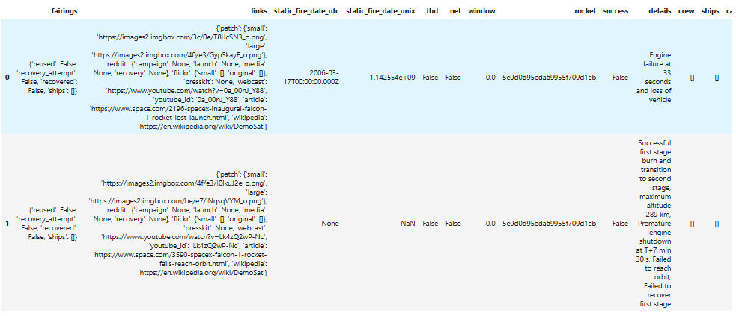
Data Collection – SpaceX API
DATAFRAME DISPLAYING FIRST FEW ROWS OF DATA

Slide 7
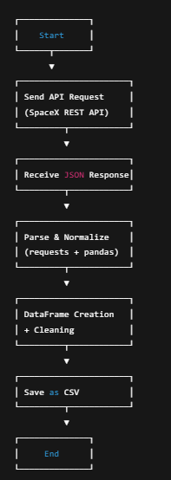
LINK TO MY REPO
https://github.com/hawk123-code/Report-Submission/blob/main/jupyter-labs-spacex-data-collection-api.ipynb Flow Chart on the right

Slide 8
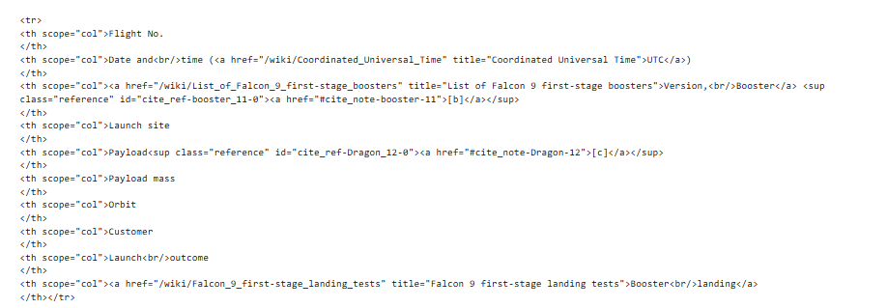
Data Collection - Scraping

Slide 9
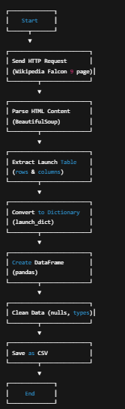
Link
https://github.com/hawk123-code/Report-Submission/blob/main/jupyter-labs-webscraping.ipynb
Web scrapping flow on right

Slide 10
Data Wrangling
Steps:
Cleaning
Merging
Feature creation.
https://github.com/hawk123-code/Report-Submission/blob/main/labs-jupyter-spacex-Data%20wrangling.ipynb

Slide 11
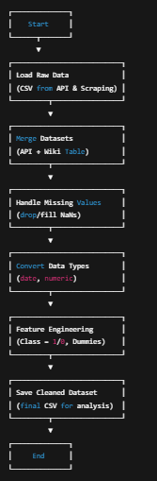
Flow Chart

Slide 12
EDA with Data Visualization
SQL queries, visualization, folium, dashboards.
Tools used:
Pandas
Matplotlib
Seaborn
Folium
Dash
scikit-learn
https://github.com/hawk123-code/Report-Submission/blob/main/jupyter-labs-eda-sql-coursera_sqllite.ipynb

Slide 13
Build an Interactive Map with Folium
Markers
Added markers for each launch site location (CCAFS, KSC, VAFB).
Purpose: Show geographic distribution of SpaceX launch facilities.
Circle Markers (Green/Red)
Represented launch outcomes:
Purpose: Provide quick visual feedback on success/failure at each location.
Each marker displays Launch Site name + Outcome when clicked.
Purpose: Make map interactive and informative.
Circles (Large radius)
Plotted around NASA Johnson Space Center (reference point).
Purpose: Provide geographical context and scale reference.
https://github.com/hawk123-code/Report-Submission/blob/main/lab_jupyter_launch_site_location.ipynb

Slide 14
Build a Dashboard with Plotly Dash
Dropdown (Launch Site Selector)
Allows users to select All Sites or a specific launch site.
Purpose: Enables comparison of overall vs site-specific success rates.
Pie Chart (Launch Success Distribution)
For “All Sites”: Shows total successful launches per site.
For selected site: Shows Success vs Failure ratio.
Purpose: Gives a clear overview of performance by site.
Range Slider (Payload Mass Selector)
Lets users filter launches by payload mass range.
Purpose: Analyze how payload size influences launch success.
Scatter Plot (Payload vs Launch Success)
X-axis = Payload Mass (kg), Y-axis = Success (Class).
Colored by Booster Version Category.
Purpose: Reveal relationships between payload size, booster type, and landing outcome
. https://github.com/hawk123-code/Report-Submission/blob/main/spacex-dash-app.py

Slide 15
Predictive Analysis (Classification)
Data Preparation
Used preprocessed dataset (dataset_part_3.csv) with 83 features (one-hot encoded categorical variables).
Split data into X_train (72 samples), X_test (18 samples), Y_train, Y_test.
Model Building
Applied 4 classification models: Logistic Regression, SVM, Decision Tree, KNN.
Used GridSearchCV for hyperparameter tuning.
Model Evaluation
Measured cross-validation accuracy and test set accuracy.
Generated confusion matrices for each model.

Slide 16
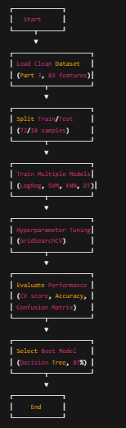
Predictive Analysis (Classification)
Model Improvement
Tuned parameters such as:
Logistic Regression → penalty & C
SVM → kernel, C, gamma
Decision Tree → max depth, min samples split, criterion
KNN → n_neighbors, p
Best Model Selection
All models achieved ~83% test accuracy.
Decision Tree gave the highest cross-validation score (87.3%).
Chosen as best-performing model.

Slide 17
Results
Flight Number vs Launch Site (Scatter Plot)
Shows increasing success with higher flight numbers (SpaceX learning curve).
Some sites (KSC LC-39A, CCAFS SLC-40) have more frequent launches.
Payload vs Launch Site (Scatter Plot)
Larger payloads (above ~6000 kg) generally launched from CCAFS.
Higher payloads sometimes reduce landing success probability.
Success Rate by Orbit Type (Bar Chart)
Certain orbits (ISS, LEO) show higher success rates.
High-energy orbits (GTO, GEO) show more failures.
Flight Number vs Orbit (Scatter Plot)
Early launches used fewer orbit types.
As experience grew, SpaceX expanded to multiple orbits.
Payload vs Orbit Type (Scatter Plot)
Payload distribution varies heavily by orbit.
ISS/LEO payloads typically lighter, GTO payloads heavier.
Yearly Launch Success Trend (Line Chart)
Sharp improvement after 2015 → nearly all landings successful.

Slide 18

Section 2

Slide 19
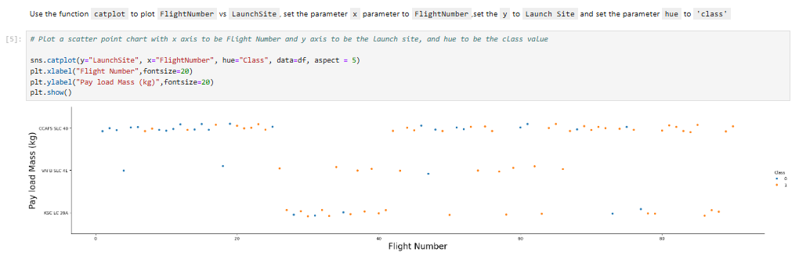
Flight Number vs. Launch Site

Slide 20
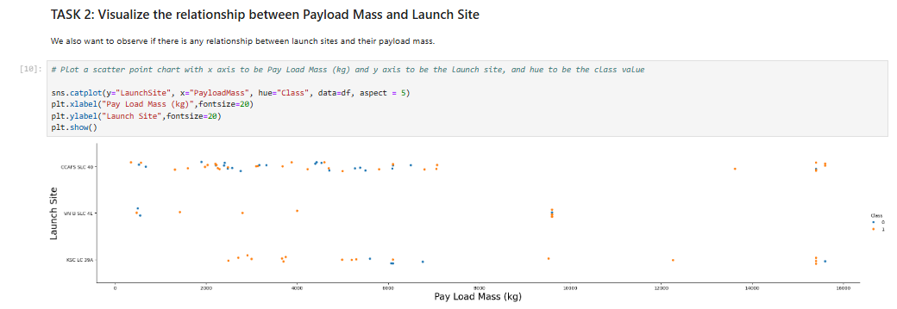
Payload vs. Launch Site

Slide 21
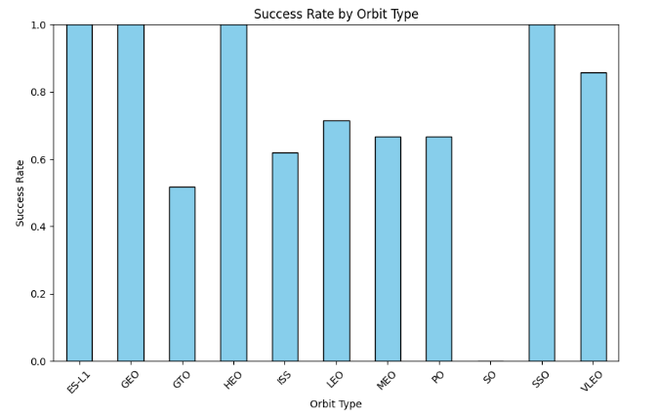
Success Rate vs. Orbit Type

Slide 22
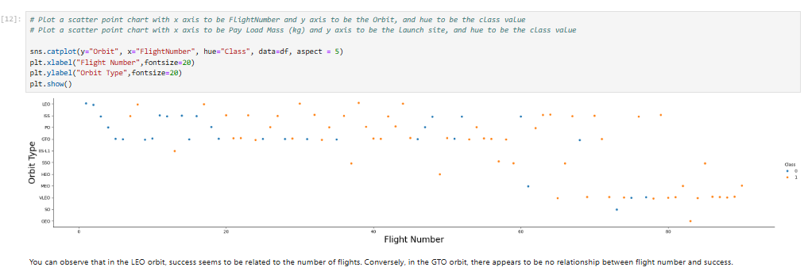
Flight Number vs. Orbit Type

Slide 23
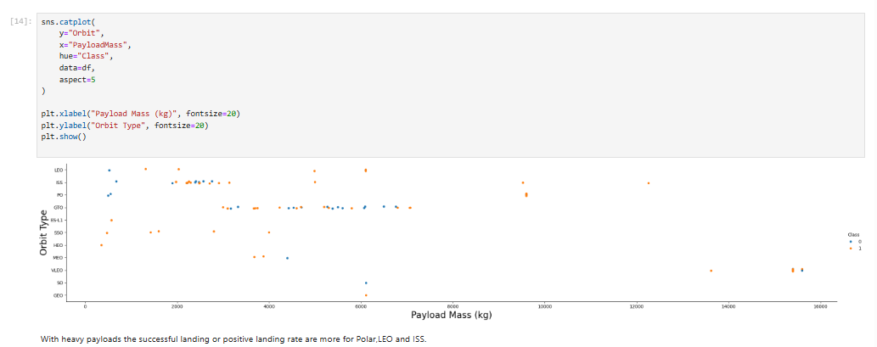
Payload vs. Orbit Type

Slide 24
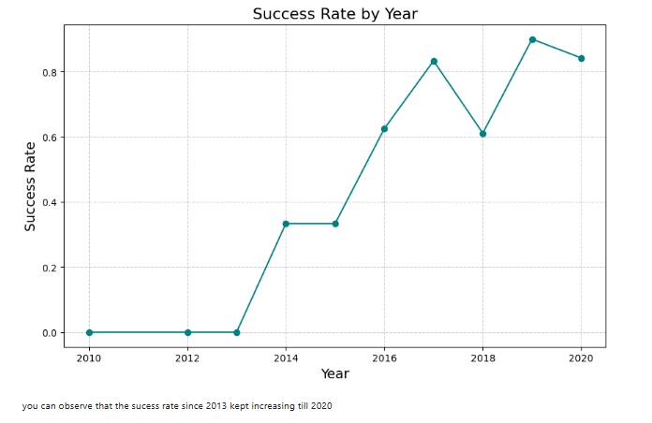
Launch Success Yearly Trend

Slide 25
All Launch Site Names
%sql SELECT DISTINCT Launch_Site FROM SPACEXTABLE;
Launch_Site
CCAFS LC-40
VAFB SLC-4E
KSC LC-39A
CCAFS SLC-40

Slide 26
Launch Site Names Begin with 'CCA'
%sql SELECT * FROM SPACEXTABLE WHERE Launch_Site LIKE 'CCA%' LIMIT 5;
Date | Time (UTC) | Booster_Version | Launch_Site | Payload | PAYLOAD_MASS__KG_ | Orbit | Customer | Mission_Outcome | Landing_Outcome
2010-06-04 | 18:45:00 | F9 v1.0 B0003 | CCAFS LC-40 | Dragon Spacecraft Qualification Unit | 0 | LEO | SpaceX | Success | Failure (parachute)
2010-12-08 | 15:43:00 | F9 v1.0 B0004 | CCAFS LC-40 | Dragon demo flight C1, two CubeSats, barrel of Brouere cheese | 0 | LEO (ISS) | NASA (COTS) NRO | Success | Failure (parachute)
2012-05-22 | 7:44:00 | F9 v1.0 B0005 | CCAFS LC-40 | Dragon demo flight C2 | 525 | LEO (ISS) | NASA (COTS) | Success | No attempt
2012-10-08 | 0:35:00 | F9 v1.0 B0006 | CCAFS LC-40 | SpaceX CRS-1 | 500 | LEO (ISS) | NASA (CRS) | Success | No attempt
2013-03-01 | 15:10:00 | F9 v1.0 B0007 | CCAFS LC-40 | SpaceX CRS-2 | 677 | LEO (ISS) | NASA (CRS) | Success | No attempt

Slide 27
Total Payload Mass
%sql SELECT SUM(PAYLOAD_MASS__KG_) AS TotalPayloadMass FROM SPACEXTABLE WHERE Customer = 'NASA (CRS)';
TotalPayloadMass
45596

Slide 28
Average Payload Mass by F9 v1.1
SELECT Booster_Version,AVG(PAYLOAD_MASS__KG_) AS AveragePayloadMass
FROM SPACEXTBL
WHERE Booster_Version = 'F9 v1.1‘
Average Payload Mass: ≈ 2928.61 kg

Slide 29
First Successful Ground Landing Date
%sql SELECT MIN(Date) AS First_Successful_GroundPad_Landing FROM SPACEXTABLE WHERE Landing_Outcome = 'Success (ground pad)';
First_Successful_GroundPad_Landing
2015-12-22

Slide 30
Successful Drone Ship Landing with Payload between 4000 and 6000
%sql SELECT DISTINCT Booster_Version FROM SPACEXTABLE WHERE Landing_Outcome = 'Success (drone ship)' AND Payload_Mass__kg_ > 4000 AND Payload_Mass__kg_ < 6000;
Booster_Version
F9 FT B1022
F9 FT B1026
F9 FT B1021.2
F9 FT B1031.2

Slide 31
Total Number of Successful and Failure Mission Outcomes
%sql SELECT Mission_Outcome, COUNT(*) AS Total FROM SPACEXTABLE GROUP BY Mission_Outcome;
Mission_Outcome | Total
Failure (in flight) | 1
Success | 98
Success | 1
Success (payload status unclear) | 1

Slide 32
Boosters Carried Maximum Payload
%sql SELECT Booster_Version, Payload_Mass__kg_ FROM SPACEXTABLE WHERE Payload_Mass__kg_ = (SELECT MAX(Payload_Mass__kg_) FROM SPACEXTABLE);
Booster_Version | PAYLOAD_MASS__KG_
F9 B5 B1048.4 | 15600
F9 B5 B1049.4 | 15600
F9 B5 B1051.3 | 15600
F9 B5 B1056.4 | 15600
F9 B5 B1048.5 | 15600
F9 B5 B1051.4 | 15600
F9 B5 B1049.5 | 15600
F9 B5 B1060.2 | 15600
F9 B5 B1058.3 | 15600
F9 B5 B1051.6 | 15600
F9 B5 B1060.3 | 15600
F9 B5 B1049.7 | 15600

Slide 33
2015 Launch Records
%sql SELECT substr(Date, 6, 2) AS Month,Landing_Outcome,Booster_Version,Launch_Site FROM SPACEXTABLE WHERE Landing_Outcome LIKE '%Failure (drone ship)%' AND substr(Date, 1, 4) = '2015';
Month | Landing_Outcome | Booster_Version | Launch_Site
01 | Failure (drone ship) | F9 v1.1 B1012 | CCAFS LC-40
04 | Failure (drone ship) | F9 v1.1 B1015 | CCAFS LC-40

Slide 34
Rank Landing Outcomes Between 2010-06-04 and 2017-03-20
%sql SELECT Landing_Outcome,COUNT(*) AS outcome_count FROM SPACEXTABLE WHERE Date BETWEEN '2010-06-04' AND '2017-03-20' GROUP BY Landing_Outcome ORDER BY outcome_count DESC;
Landing_Outcome | outcome_count
No attempt | 10
Success (drone ship) | 5
Failure (drone ship) | 5
Success (ground pad) | 3
Controlled (ocean) | 3
Uncontrolled (ocean) | 2
Failure (parachute) | 2
Precluded (drone ship) | 1

Slide 35

Section 3

Slide 36
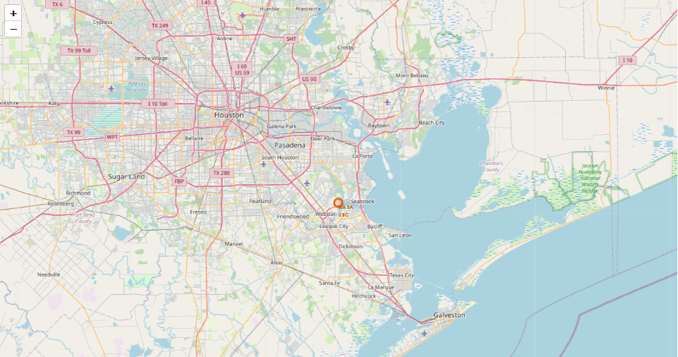
Folium Map With NASA Location

Slide 37
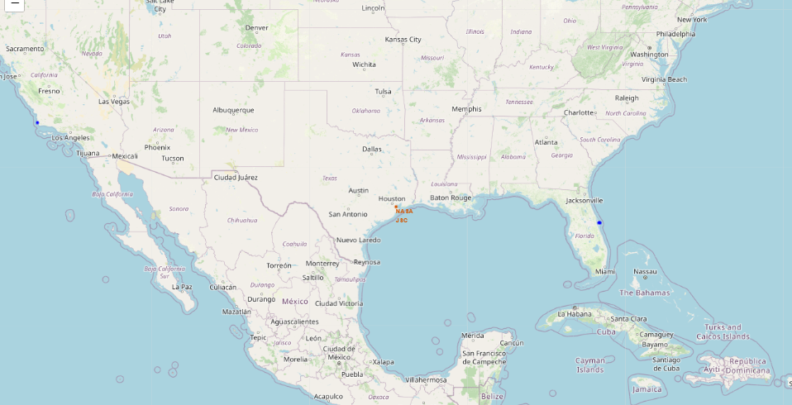
Folium Map With Data frame Locations

Slide 38
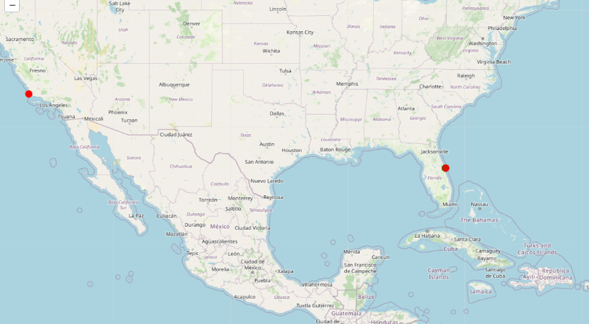
<Folium Map Red as Failure>

Slide 39

Section 4

Slide 40
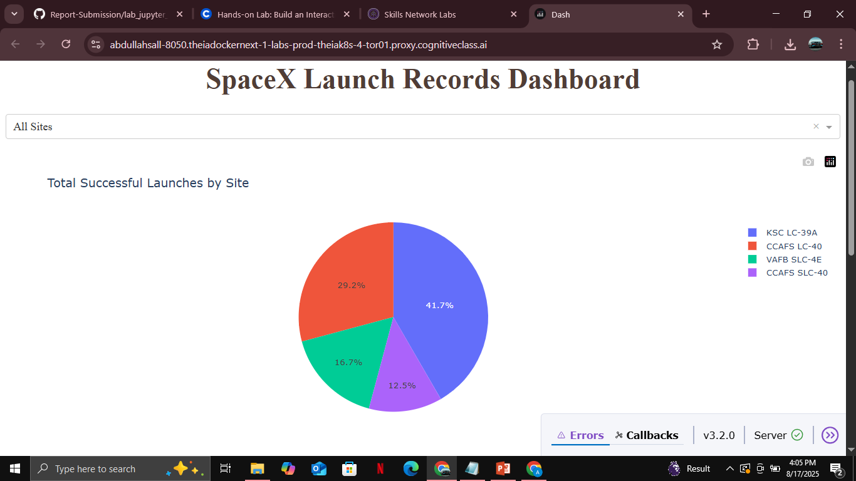
Pie Chart With Launch Site Proportions

Slide 41
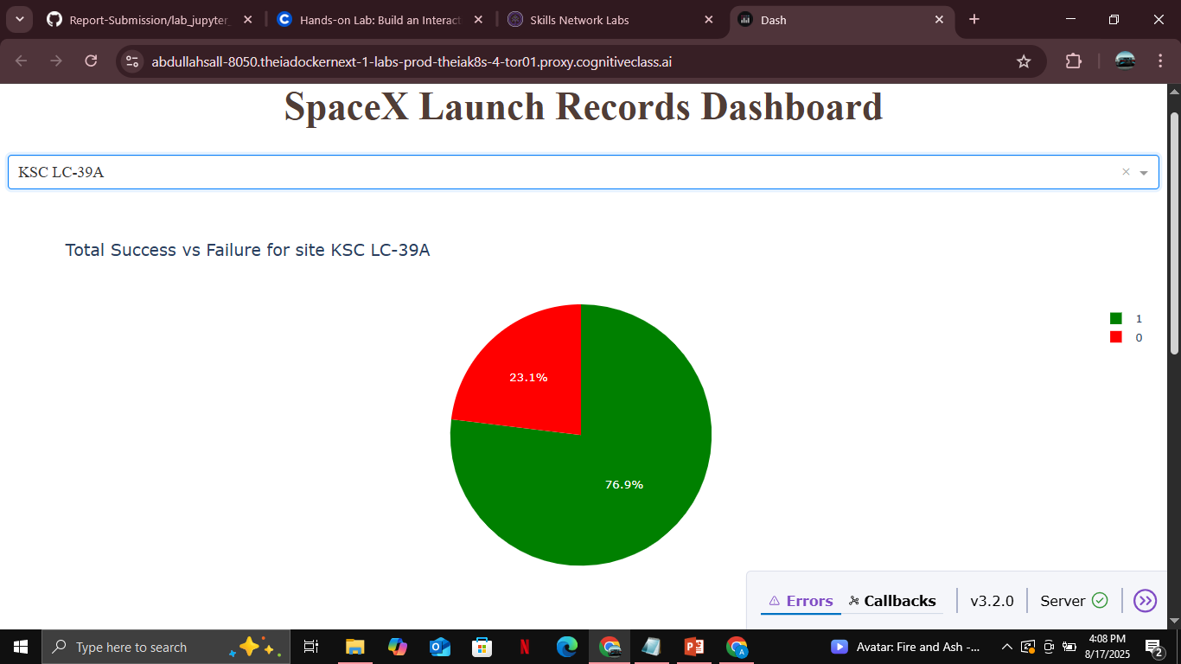
Graph Highest Launch Success Ratio

Slide 42
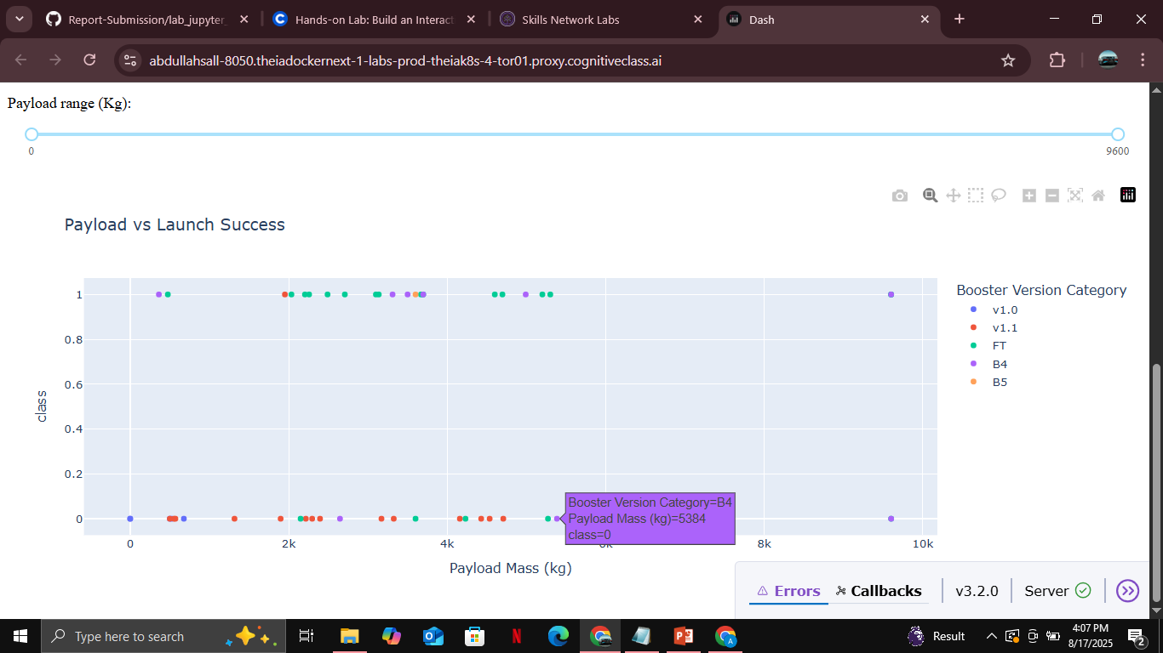
Payload vs Launch Success

Slide 43

Section 5

Slide 44
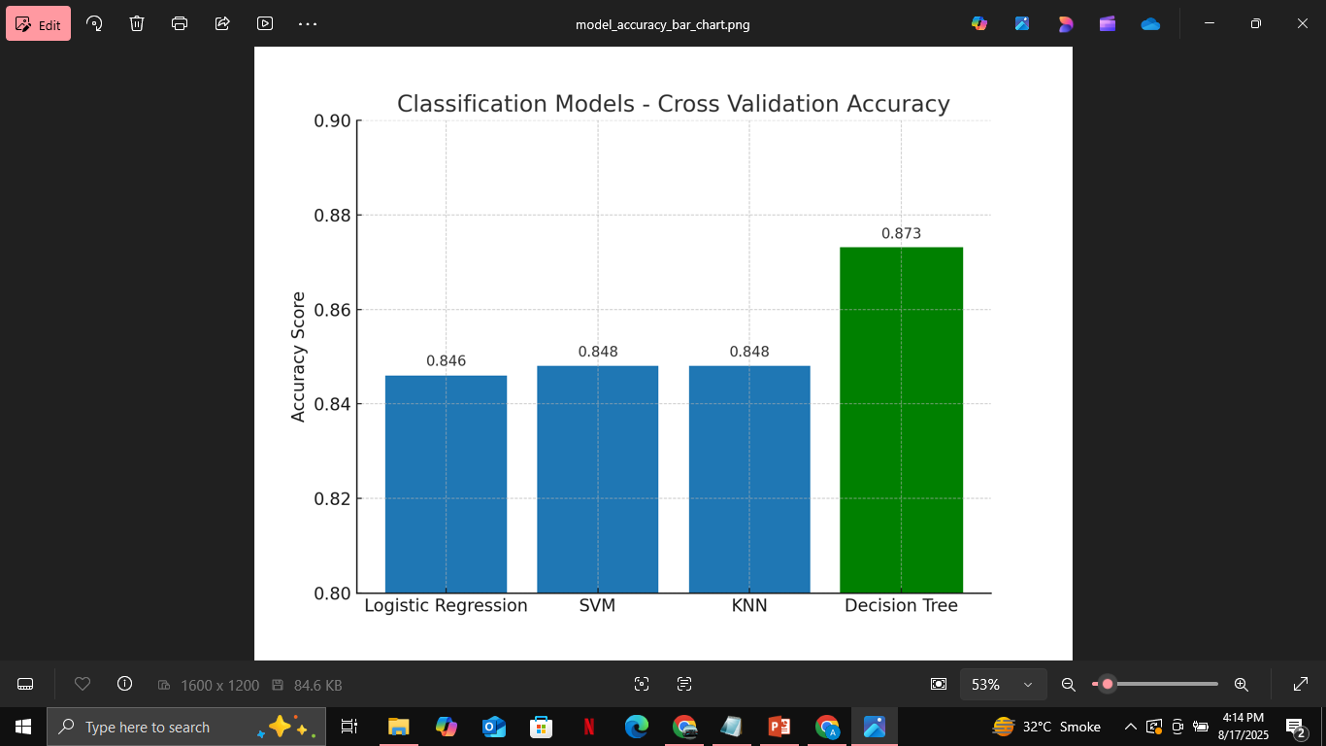
Classification Accuracy

Slide 45
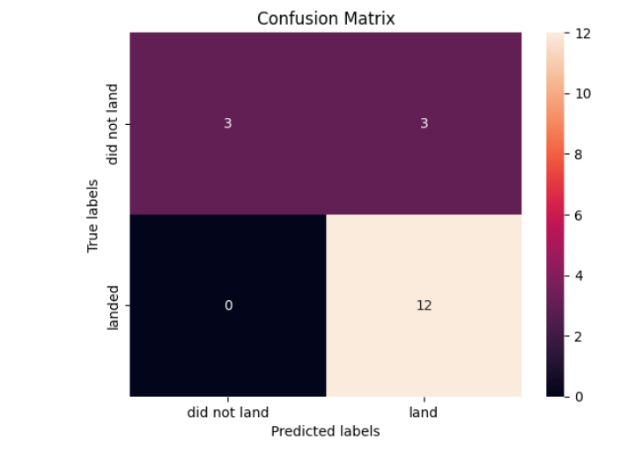
Confusion Matrix
Tree_CV confusion matrix

Slide 46
Conclusions
Point 1: SpaceX Falcon 9 data was successfully collected from Wikipedia (web scraping) and the SpaceX API, then wrangled into a clean dataset.
Point 2: Exploratory Data Analysis (EDA) revealed trends: launch success improves with higher flight numbers, payload size and orbit type affect outcomes, and yearly success rates show rapid improvement after 2015.
Point 3: Interactive analytics using Folium maps and Dash dashboards provided intuitive visual insights into launch sites, outcomes, and payload effects.
Point 4: Predictive modeling with multiple classifiers showed that all models achieved ~83% accuracy, with the Decision Tree model performing best (87% CV score).
Point 5: Findings highlight how data science can support aerospace engineering by identifying factors influencing rocket landing success and reducing launch costs.

Slide 47
Appendix
Web Scraping (Wikipedia Falcon 9 launches)
import requests
from bs4 import BeautifulSoup
import pandas as pd
url = "https://en.wikipedia.org/wiki/List_of_Falcon_9_and_Falcon_Heavy_launches"
response = requests.get(url).text
soup = BeautifulSoup(response, "html.parser")
# Extract launch table and convert to DataFrame

Slide 48
Appendix
SpaceX API Call
import requests
import pandas as pd
api_url = "https://api.spacexdata.com/v4/launches"
response = requests.get(api_url)
data = response.json()
df = pd.json_normalize(data)

Slide 49
Appendix
Example Machine Learning (Decision Tree)
from sklearn.tree import DecisionTreeClassifier
from sklearn.model_selection import train_test_split, GridSearchCV
X_train, X_test, y_train, y_test = train_test_split(X, Y, test_size=0.2)
param_grid = {'criterion': ['gini','entropy'], 'max_depth': [4,6,8]}
grid = GridSearchCV(DecisionTreeClassifier(), param_grid, cv=10)
grid.fit(X_train, y_train)

Slide 50
2. SQL Queries
Average Payload Mass by F9 v1.1
SELECT Booster_Version, AVG(PAYLOAD_MASS__KG_) AS AveragePayloadMass
FROM SPACEXTBL
WHERE Booster_Version = 'F9 v1.1';
Total Successful & Failed Missions
SELECT Mission_Outcome, COUNT(*) AS Total
FROM SPACEXTBL
GROUP BY Mission_Outcome;
First Successful Ground Landing
SELECT MIN(Date) AS First_Successful_Ground_Landing
FROM SPACEXTBL
WHERE Landing_Outcome = 'Success (ground pad)';

Slide 51
Appendix
5. Datasets Used
dataset_part_1.csv → Wrangling dataset
dataset_part_2.csv → Visualization & EDA
dataset_part_3.csv → Predictive modeling
spacex_launch_geo.csv → Folium maps
spacex_launch_dash.csv → Dash dashboard
All graphs and plots are included in the powerpoint

Slide 52


